Slide 1
Unified Modeling Language (UML)
Presenting by
Shreya Chippagiri and Aravindan M
From Group -6

Slide 2
What is UML?
Is a Modeling language
Language defines
Syntax – Symbols and rules for using them
Semantics – What these symbols represent
UML is a graphical language
Picture models provide better feel of system (a picture is worth a thousand words).
Language to express different types of models

Slide 3
Usage of UML
UML can be used to
Visualize (Graphical Notation)
Specify (Complete and Unambiguous)
Construct (Code Generation)
UML is a language for constructing new as well as understanding existing system
In software work more than 70% of time spent on analyzing existing systems

Slide 4
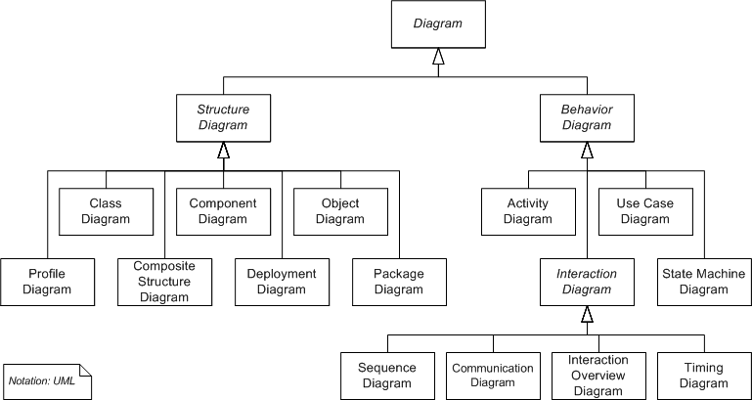
UML Diagrams

Slide 5
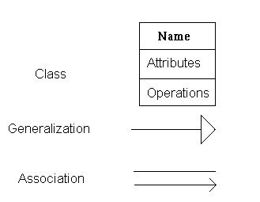
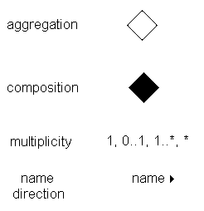
UML Notation

Slide 6
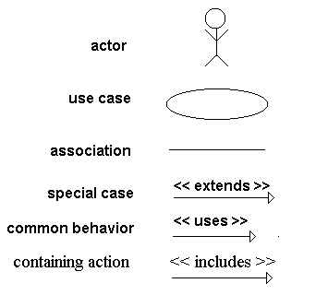
Use Case Diagram
For capturing the functional requirements of a system.
Notations:

Slide 7
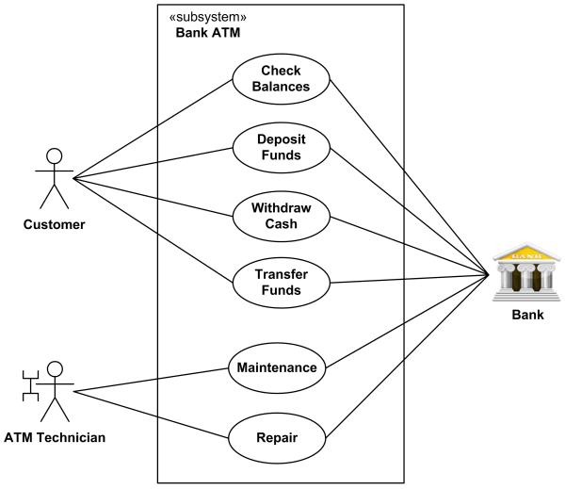
Example for use case diagram:

Slide 8

Benefits of Use Cases
Acts as the first step in solution process – understand the ‘situation’ better
Allows us to focus on important functionalities related to end user

Slide 9
Class Diagram
CLASS
Class Name
Number of links each class object may contain
#
Class 1
Composition relationship
Class 1 is composed of a Class 2
Class 2
Class 1
Class 2
Aggregation
A collection of other classes
Class 1
Inheritance relationship
Class 2 and Class 3 derive from Class 1
Class 2
Class 3

Slide 10
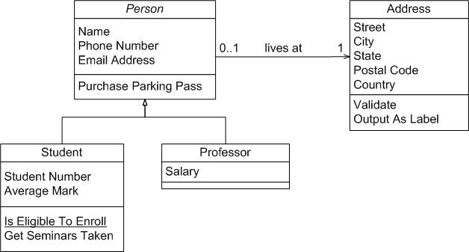
Example for Class Diagram:

Slide 11
Sequence Diagram
show the interaction of objects with respect to time
Sequence diagrams have two axes
horizontal axis represents the objects involved in a sequence.
vertical axis represents the passage of time

Slide 12
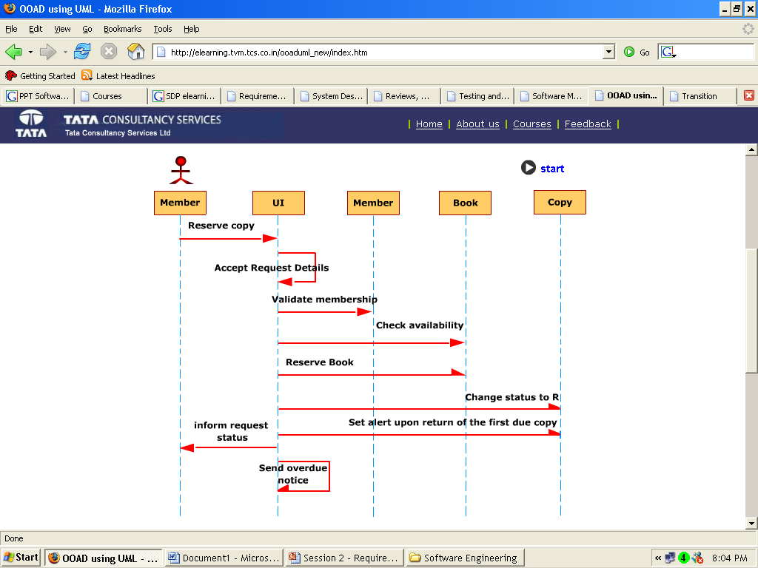
Example for Sequence Diagram:

Slide 13
Collaboration Diagram
Shows the interaction of the objects and also the group of all messages sent or received by an object.
Allows us to see the complete set of services that an object must provide.

Slide 14
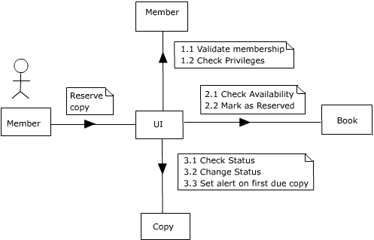
Example for Collaboration Diagram:

Slide 15
Statechart Diagram
A statechart diagram shows the behavior of classes in response to external stimuli
This diagram models the dynamic flow of control from state to state within a system

Slide 16

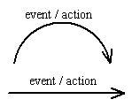


Basic Statechart Diagram Symbols and Notations :
States represent situations during the life of an object
A solid arrow represents the path between different states of an object
A filled circle followed by an arrow represents the object's initial state
An arrow pointing to a filled circle nested inside another circle represents the object's final state.

Slide 17
Activity Diagram

